Slide 1
SYNOPTIC-ALIGNED v2
Heat–Pollution Nexus
in Mumbai
Spearman Correlation Analysis — Synoptic-Period Aligned
Santacruz (43003) × Colaba (43057) | CPCB Data 2019–2025
Santacruz (43003) — Inland
Colaba (43057) — Coastal
8 PLOTS
3 PERIODS
~8,467
~5,493
Analysed
Aligned obs./day
Santacruz rows
Colaba rows

Slide 2
Why Synoptic Alignment Was Necessary
BEFORE — Unequal Sampling
AFTER — Aligned Sampling
Santacruz rows:
~155,000 (8 synoptic periods/day)
Santacruz rows:
~8,467 (filtered to 3 matching periods)
Colaba rows:
~55,000 (only 3 periods/day)
Colaba rows:
~5,493 (unchanged — control)
→
Ratio:
2.8× more data for Santacruz
Match:
Same synoptic HR codes at both stations
Effect:
Extra nighttime / early-morning hours inflated cold-polluted winter observations
Effect:
Removes cold-night sampling bias; both stations observe identical time windows
Result:
PM2.5–HI, CO–HI correlations artificially exaggerated by ~10%
Result:
Fair, directly comparable correlations — valid for publication
Mam's correction: filter Santacruz to the 3 synoptic periods Colaba observes, then recompute all correlations. Colaba values confirmed identical — valid control.

Slide 3
Before vs After Alignment — Key Correlation Changes (Santacruz)
Pollutant
r_HI Before
r_HI After
Δ
r_PET Before
r_PET After
Key insight
PM2.5
-0.421
-0.376
+0.045
-0.113
-0.016
PET link was spurious
PM10
-0.364
-0.317
+0.046
-0.074
+0.029
PET sign flipped
NO₂
-0.160
-0.157
≈ 0
+0.073
+0.119
PET link stronger
NH₃
-0.175
-0.158
+0.017
-0.083
-0.047
Minor bias
SO₂
-0.069
-0.072
≈ 0
-0.005
+0.010
Both near-zero
CO
-0.403
-0.366
+0.038
-0.199
-0.121
PET link halved
Ozone
+0.104
+0.056
-0.048
+0.175
+0.142
Overestimated
AQI_max
-0.370
-0.324
+0.046
-0.080
+0.021
PET sign flipped
HAPSI
+0.942
+0.955
+0.013
+0.899
+0.879
Even stronger ↑

Slide 4
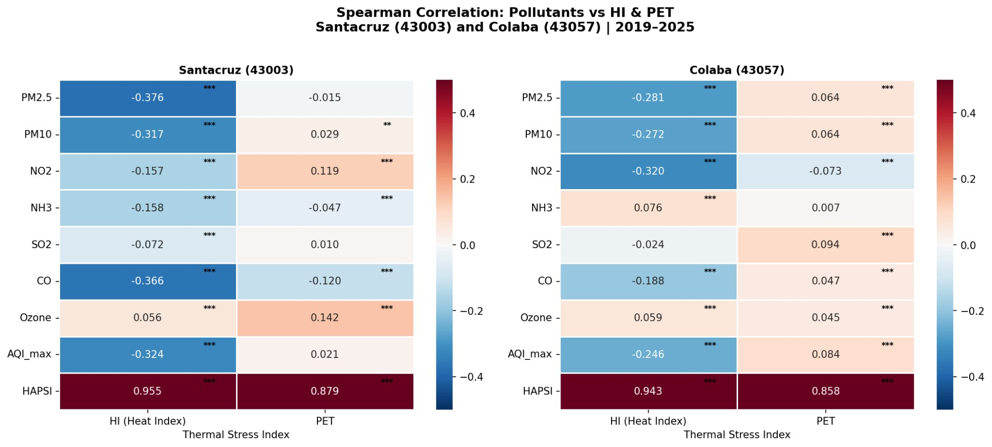
Spearman Correlation Heatmap — Aligned Data
HAPSI r=0.955 (HI) is the strongest signal — even stronger post-alignment. PM2.5 & CO negative correlations reduced from ~−0.42/−0.40 to ~−0.38/−0.37, now bias-free.

Slide 5
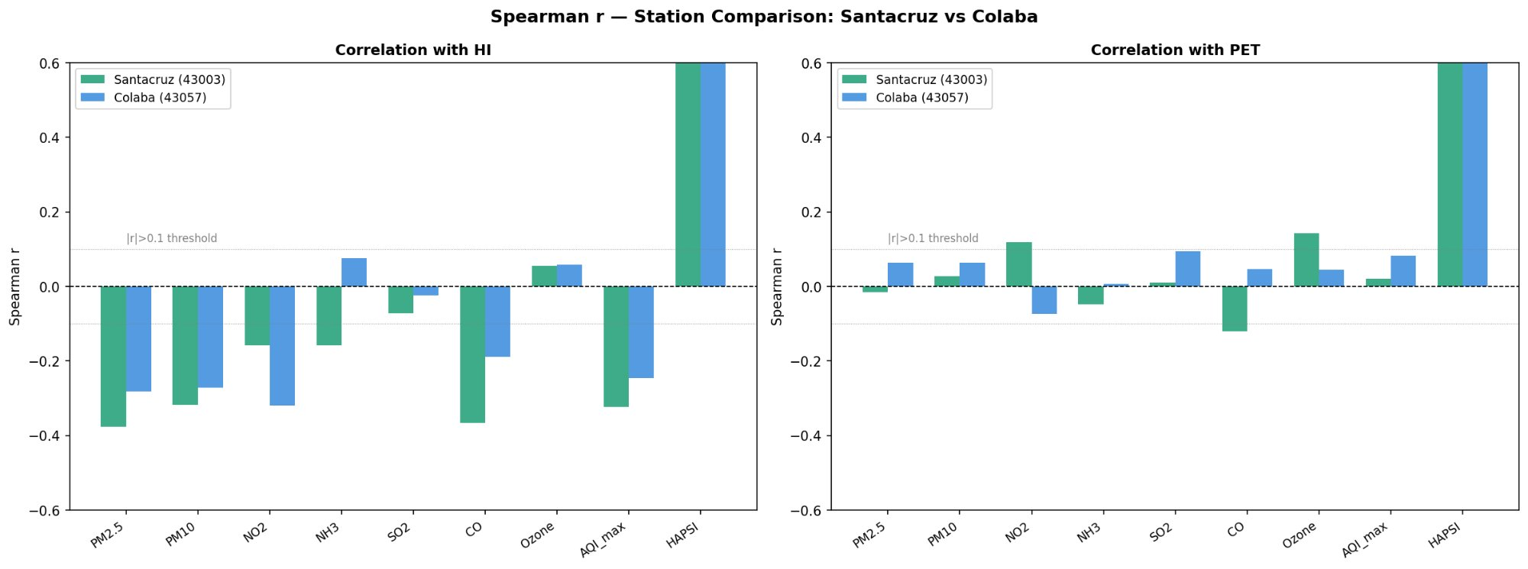
Station Comparison — Santacruz vs Colaba (Aligned)
Santacruz still stronger
NO₂ pattern reversal
HAPSI convergence
Even after removing sampling bias, PM2.5–HI (−0.376) and CO–HI (−0.366) remain more negative than Colaba's −0.281 and −0.188 — a genuine inland vs coastal difference.
At Colaba, NO₂–HI is −0.320 (stronger than Santacruz's −0.157), reflecting coastal traffic & shipping emissions that the sea-breeze ties to cooler conditions.
Both stations now show nearly identical HAPSI–HI strength (0.955 vs 0.943), confirming the composite index is location-robust when sampling is fair.

Slide 6
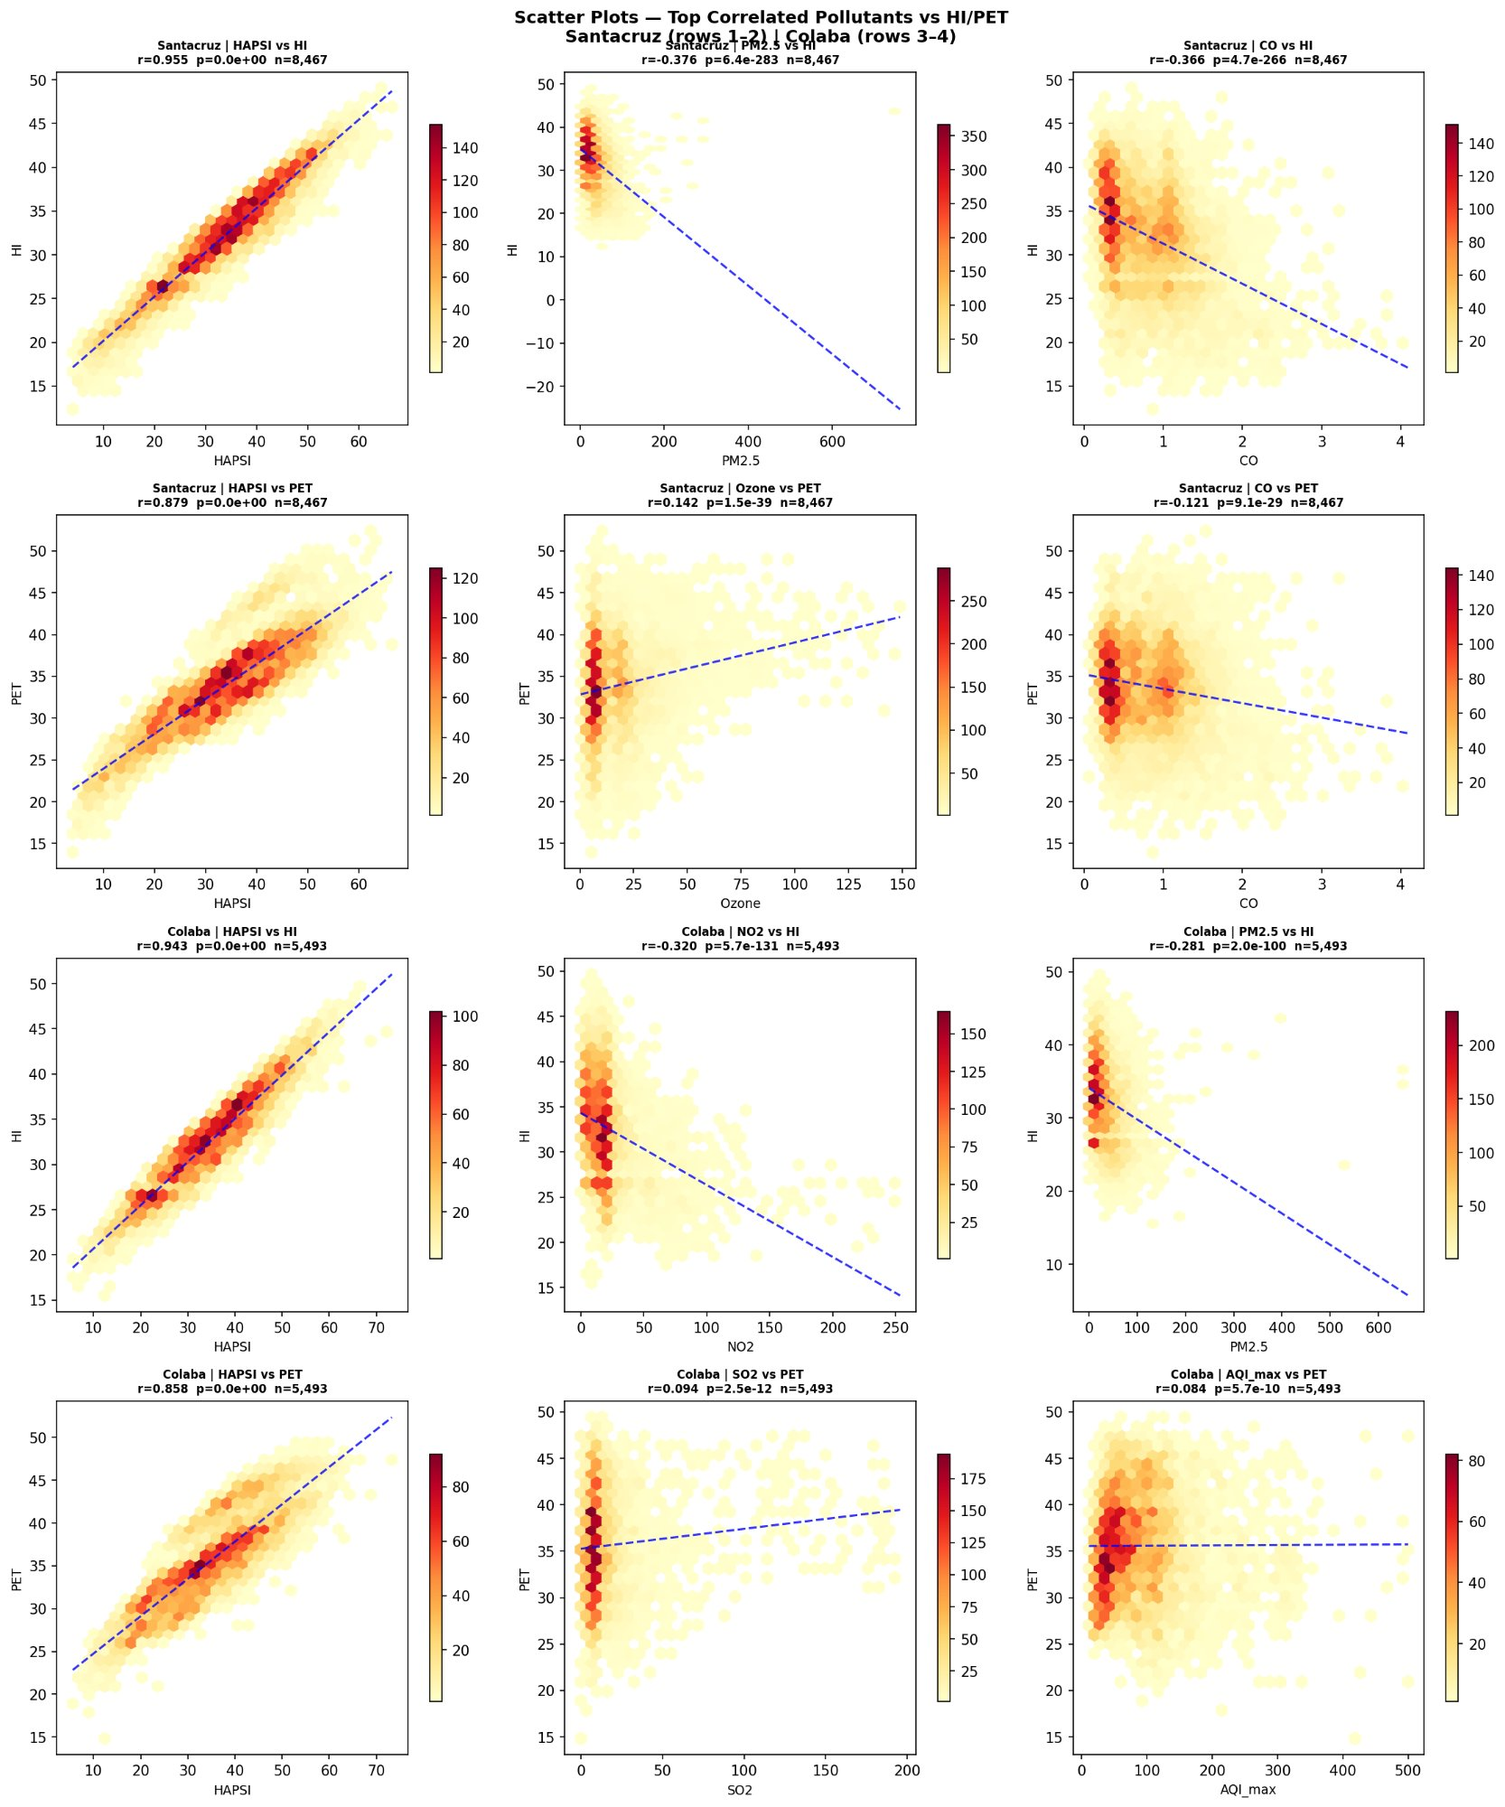
Scatter Plots — Top Correlated Pollutants vs HI / PET
Santacruz n dropped from 11,088 → 8,467 after alignment. HAPSI–HI near-linear (r=0.955). PM2.5 & CO scatter less extreme — fewer artificial cold-night outliers. Ozone positive slope with PET confirmed.

Slide 7
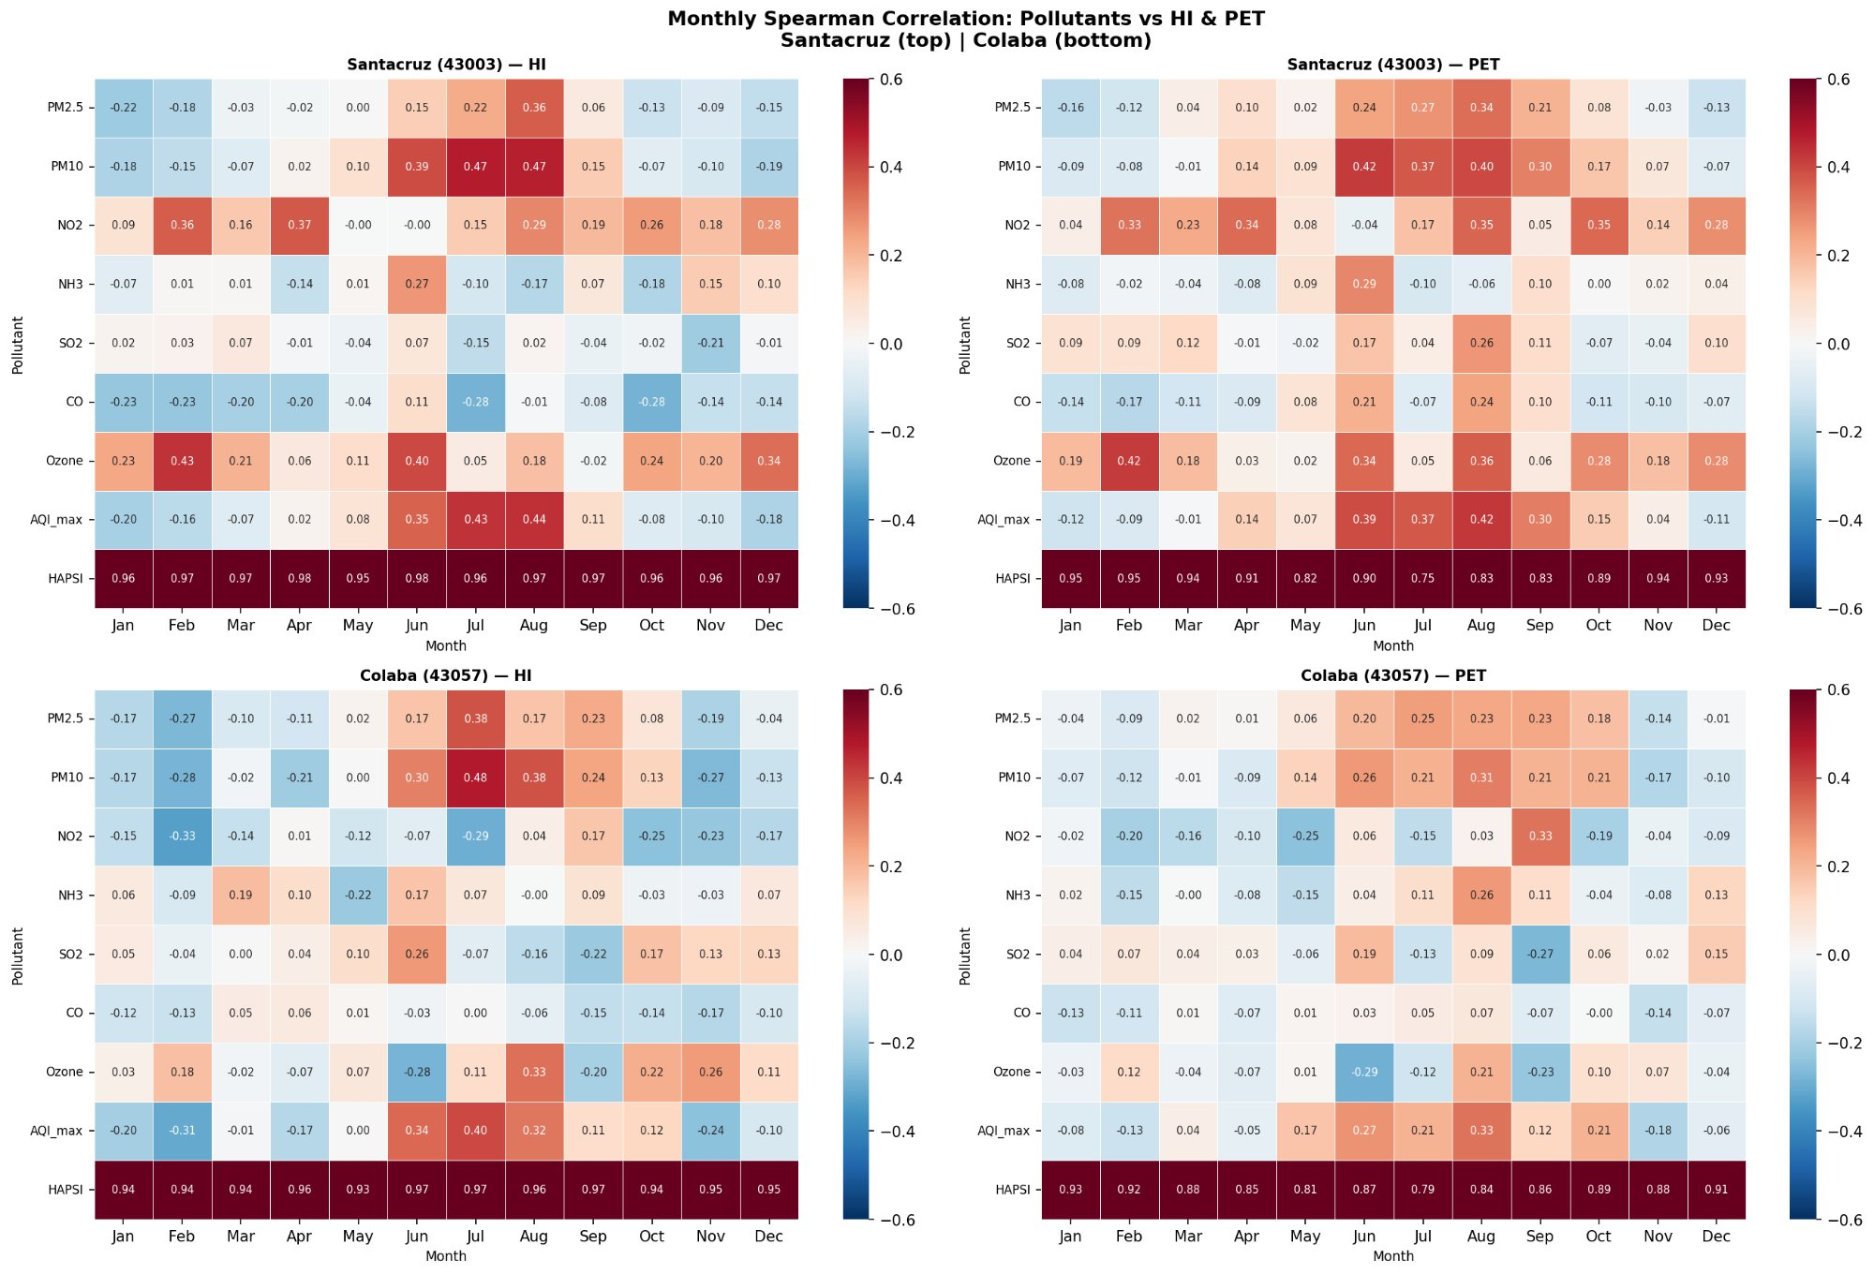
Monthly Spearman Correlation: Pollutants vs HI & PET
HAPSI–HI: consistently 0.95–0.98 every month — robust, season-independent. • PM10 & AQI_max shift to positive correlation with HI in Jul–Aug (monsoon washout effect). • Ozone shows positive r in Feb & May–Jun (peak solar radiation months).

Slide 8
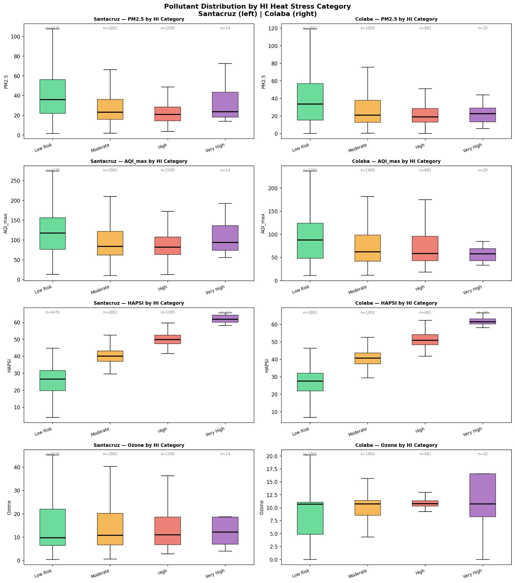
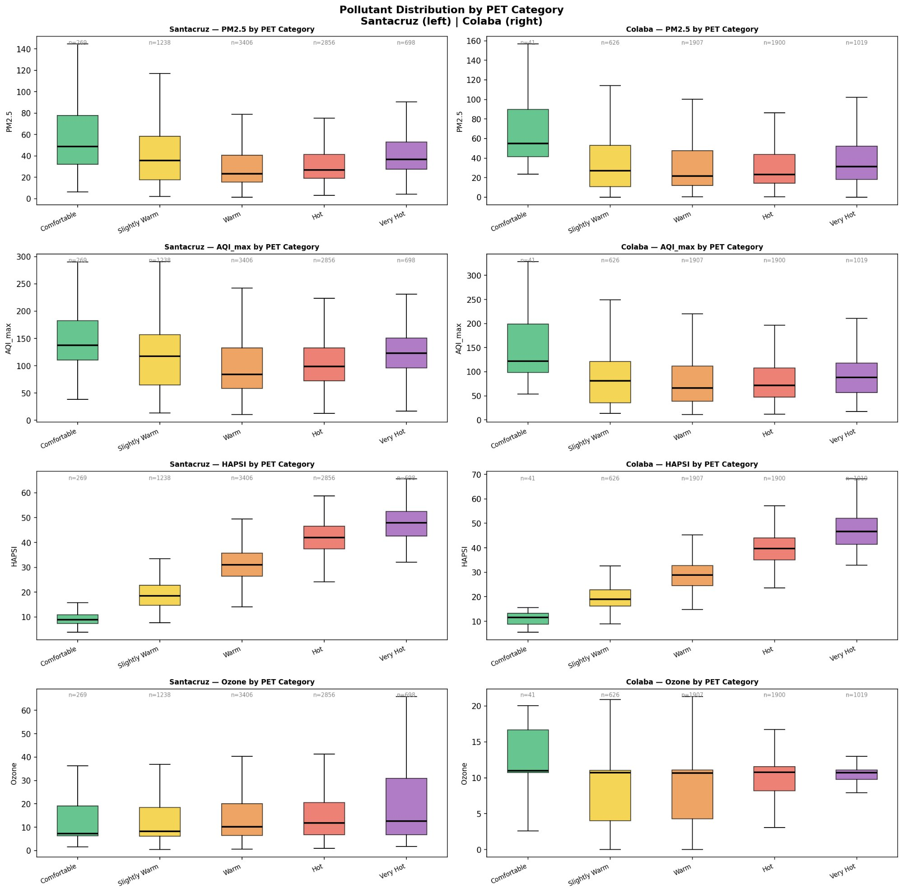
Pollutant Distribution by Thermal Stress Category
By HI (Heat Index) Category
By PET Category
PM2.5 & AQI_max highest in Low Risk / Comfortable categories (cool seasons). HAPSI rises monotonically across all heat categories at both stations. Aligned Santacruz (n≈8,467) now consistent with Colaba.

Slide 9
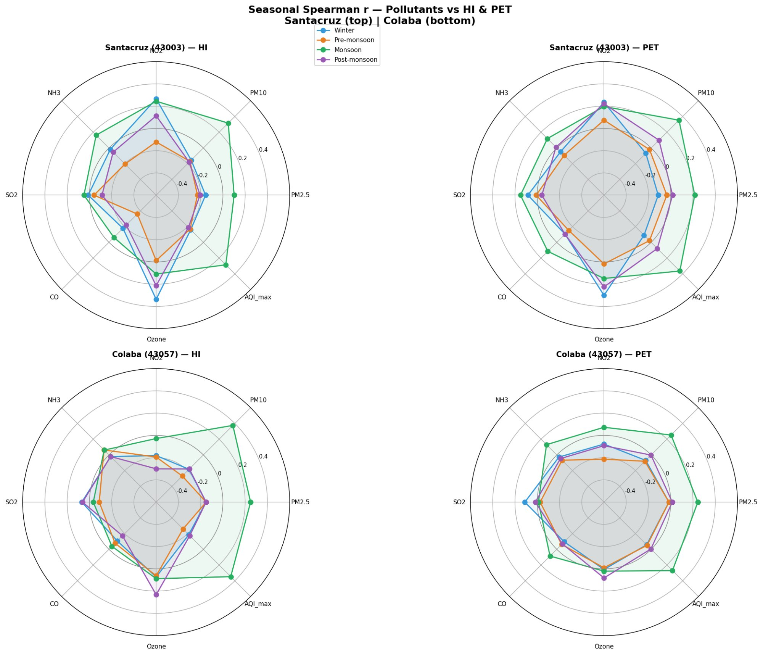
Seasonal Spearman r — Pollutants vs HI & PET
Monsoon (green) — PM10 & AQI_max flip to positive HI correlation at Colaba: rain scavenges PM but residual pollutants co-occur with sustained heat. | Winter (blue) — CO dips deepest negative at Santacruz; Colaba's CO–HI also negative but shallower due to sea-breeze dilution. | Pre-monsoon — Ozone shows strongest positive r across both stations; peak photochemical production in hot, sunny conditions.

Slide 10
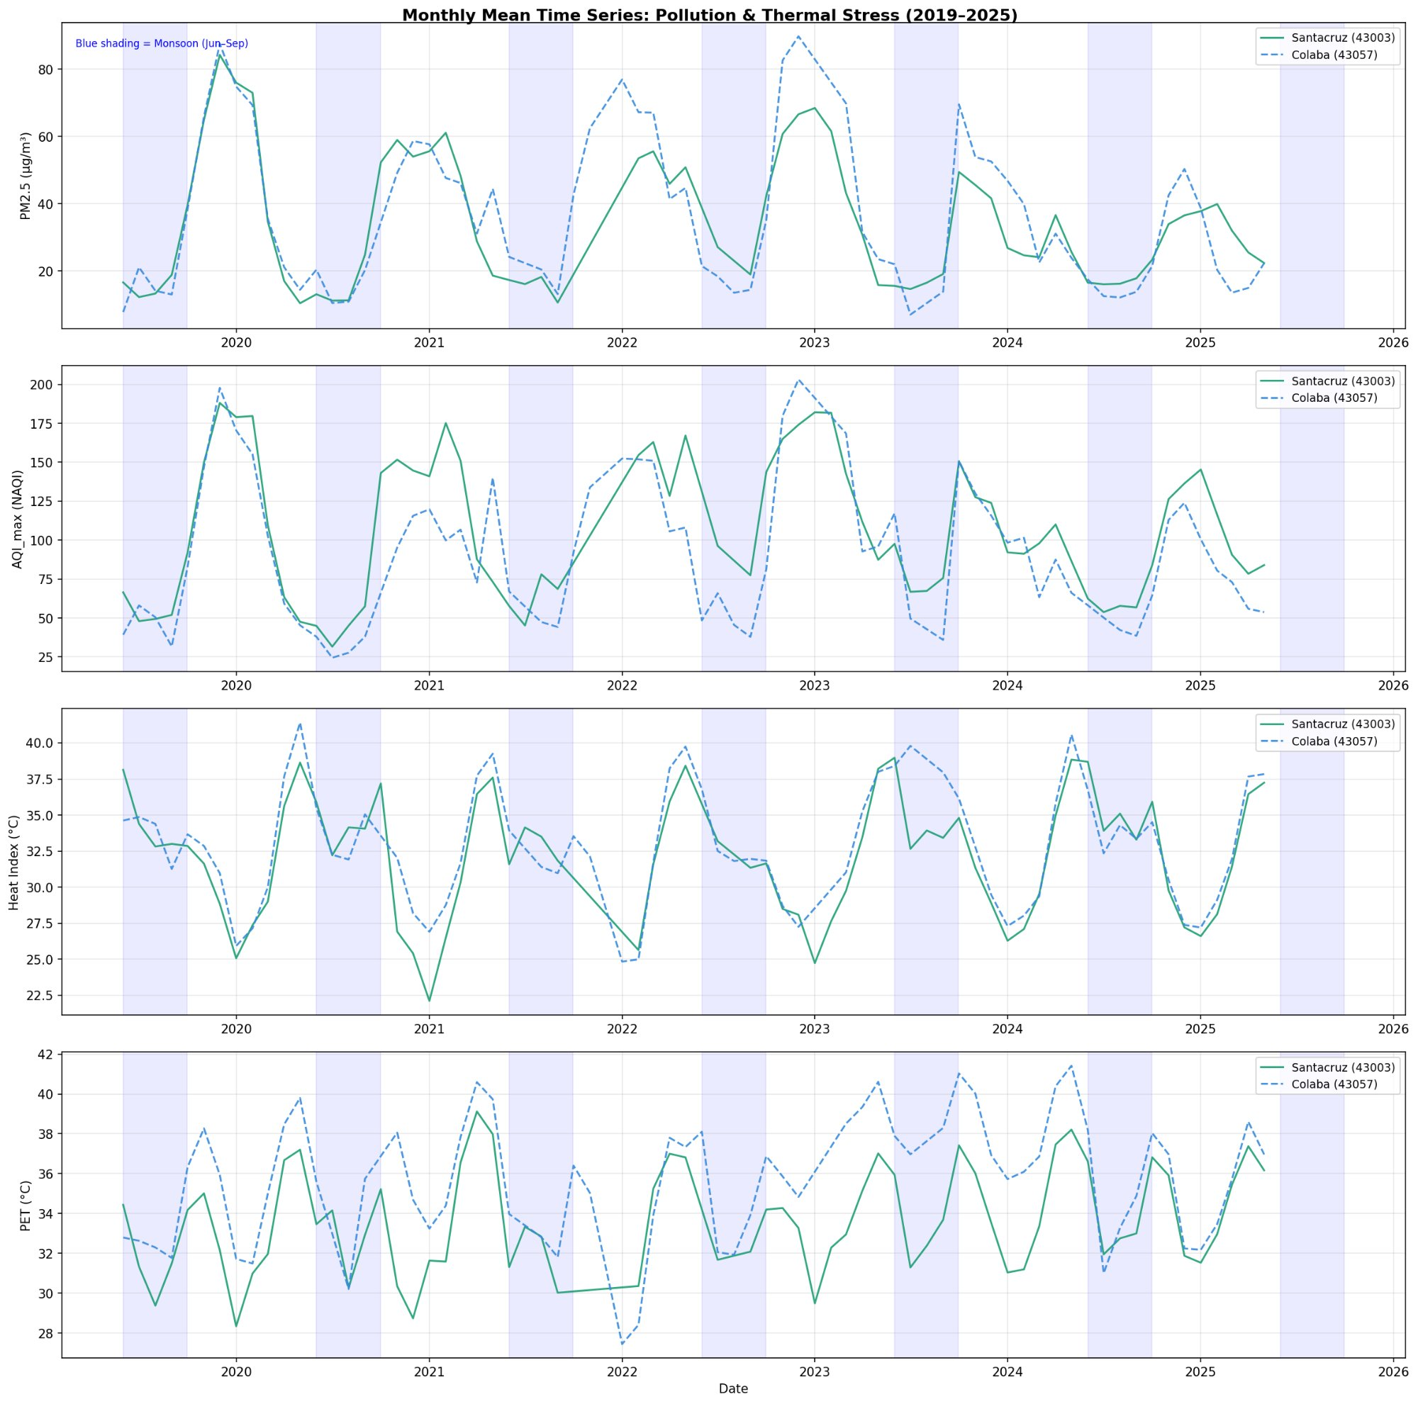
Monthly Mean Time Series: Pollution & Thermal Stress (2019–2025)
Time-series pattern unchanged by alignment (monthly averages smooth out synoptic-period effects). PM2.5 & AQI_max peak Nov–Feb; HI & PET peak Apr–Jun. Clear inverse seasonality holds across all 6 years.

Slide 11
Key Findings — Post-Alignment (Bias-Corrected)
01
HAPSI is even more robust: After removing sampling bias, HAPSI–HI r rose to 0.955 at Santacruz and holds at 0.943 at Colaba. It is the single most reliable thermal-pollution composite index across both stations and all seasons.
02
Particulate–heat inverse link is real, not exaggerated: PM2.5–HI and CO–HI are both weaker after alignment (−0.376, −0.366 vs −0.421, −0.403) but remain statistically strong (p<0.001). The winter-pollution / summer-heat trade-off is a genuine physical phenomenon.
03
PET correlations were mostly artefactual for particulates: PM2.5–PET and AQI_max–PET flipped sign after alignment (−0.113 → −0.016; −0.080 → +0.021). These near-zero post-alignment values mean PET is not a reliable predictor of particulate levels at Santacruz.
04
Ozone–heat link overestimated but directionally correct: Ozone–HI dropped from +0.104 to +0.056 after removing extra nighttime hours (when NO₂ titration is absent). The positive direction is confirmed but effect size should be reported at the lower aligned value.
05
Coastal vs inland differences now cleanly separated: Santacruz retains stronger PM2.5 & CO–heat inversions (inland traffic/combustion). Colaba shows stronger NO₂–HI link (−0.320) from coastal shipping. Sea-breeze differentiation is a genuine, not sampling-driven, contrast.

Slide 12
Conclusions & Policy Implications
Methodological
Policy Implications
Synoptic period alignment is essential before comparing stations with different observation frequencies
Winter double burden: peak PM + low HI — respiratory/cardiovascular advisories needed Nov–Feb
Correlations inflated by ~10% without alignment — critical for peer-reviewed claims
Summer single burden: high HI + low PM — heat-stress alerts and HAPSI-based public warnings
HAPSI–HI remains the dominant signal and actually strengthens post-alignment (r=0.955)
Ozone compound risk: pre-monsoon afternoons carry both heat and photochemical ozone — targeted monitoring required
PET is a weaker thermal correlate for particulates; HI is the more reliable index
Station-specific advisories: Colaba's coastal NO₂ profile needs different interventions than Santacruz's inland PM profile

Slide 13
Thank You
Heat–Pollution Nexus in Mumbai | Synoptic-Aligned Analysis
Santacruz (43003) & Colaba (43057) | CPCB 2019–2025 | Spearman Correlation
0.955
0.943
−0.376
3 periods
HAPSI–HI (Santacruz)
HAPSI–HI (Colaba)
PM2.5–HI (aligned)
Synoptic match
Correction implemented as per Jaya Mam's guidance on synoptic period alignment

